Slide 1
CSCI 6521 Advanced Machine Learning I Chapter 01: Generative Model
Md Tamjidul Hoque

Slide 2
Syllabus
Textbook for optional reading:
Hands-on Machine Learning with Scikit-Learn, Keras, and TensorFlow, 3rd Edition., by Aurélien Géron, 2023, book@UNO link.
Generative Deep Learning: Teaching Machines to Paint, Write, Compose, and Play, 2nd Edition, by David Foster.
Practical Deep Learning for Cloud, Mobile, and Edge: Real-World AI & Computer-Vision Projects Using Python, Keras & TensorFlow, by Anirudh Koul, Meher Kasam, and Siddha Ganju.
The Elements of Statistical Learning, 2nd edn, by Trevor Hastie, Robert Tibshirani and Jerome Friedman. Springer, 2009, online: http://www-stat.stanford.edu/~tibs/ElemStatLearn/
Hands On Unsupervised Learning Using Python by Ankur A. Patel.
Mark distribution:
Programming Assignments (3) → 39% [Any language is acceptable]
Homework Assignments (1) → 11%
Class Test (3) → 20% (Best 2 counts)
Final Examination → 25% (Must attend to pass)
Attendance → 5%,
Exams: Class tests: (1) Feb/13, (2) Mar/19, (3) Apr/23 [Tentative]
Final Exam: May/02/2024 (Thursday), 5:30 PM – 7:30 PM.

Slide 3
Attendance
Your attendance at class is required and essential for you to meet course requirements.
5% make is allocated for attendance and
distributed as %5: [90-100%], 4%: [85-90), 3%: [80-85), 2%: [75-80), 1%: [70-75), 0%: <70.

Slide 4
Office Hours
You can see me after the class:
Tuesday, Thursday, 6:15 PM to 8:15 PM.
Wednesday, 11:00 AM to 1:00 PM.
Otherwise, feel free to email/phone me
Email: thoque@uno.edu
Phone: (504)-280-2406

Slide 5
Assignment
The submitted assignment must be your own work.
If you find a problem with Canvas for assignment submission, please only then email me the assignment (Email: thoque@uno.edu)
You must submit both Hard & Soft copy – if indicated.
Bonus
A student who will be able to produce any publishable work (approved based on superior results, recognized by the instructor during the period of this course) related to any given assignment(s) or the topics covered in the class, will be given 10% bonus marks.
Easy venue for submission:
InnovateUNO: Oct/Nov conference @UNO.
LBRN: April conference, https://lbrn.lsu.edu/
For samples, see: https://cs.uno.edu/~tamjid/publications.html

Slide 6
… Assignment
Due Dates
Every assignment handed out will be clearly marked with a due date. You are responsible for handing in your assignment on time.
Late submissions will be assessed at the following rates:
80% for 1-48 hours (2 days max) late,
60% for 49-96 hours (2 days max) late,
40% for 97-144 (2 days max) hours late,
20% for 145-168 hours (1-day max) late.
Assignments that are more than a week late will receive no credit.

Slide 7
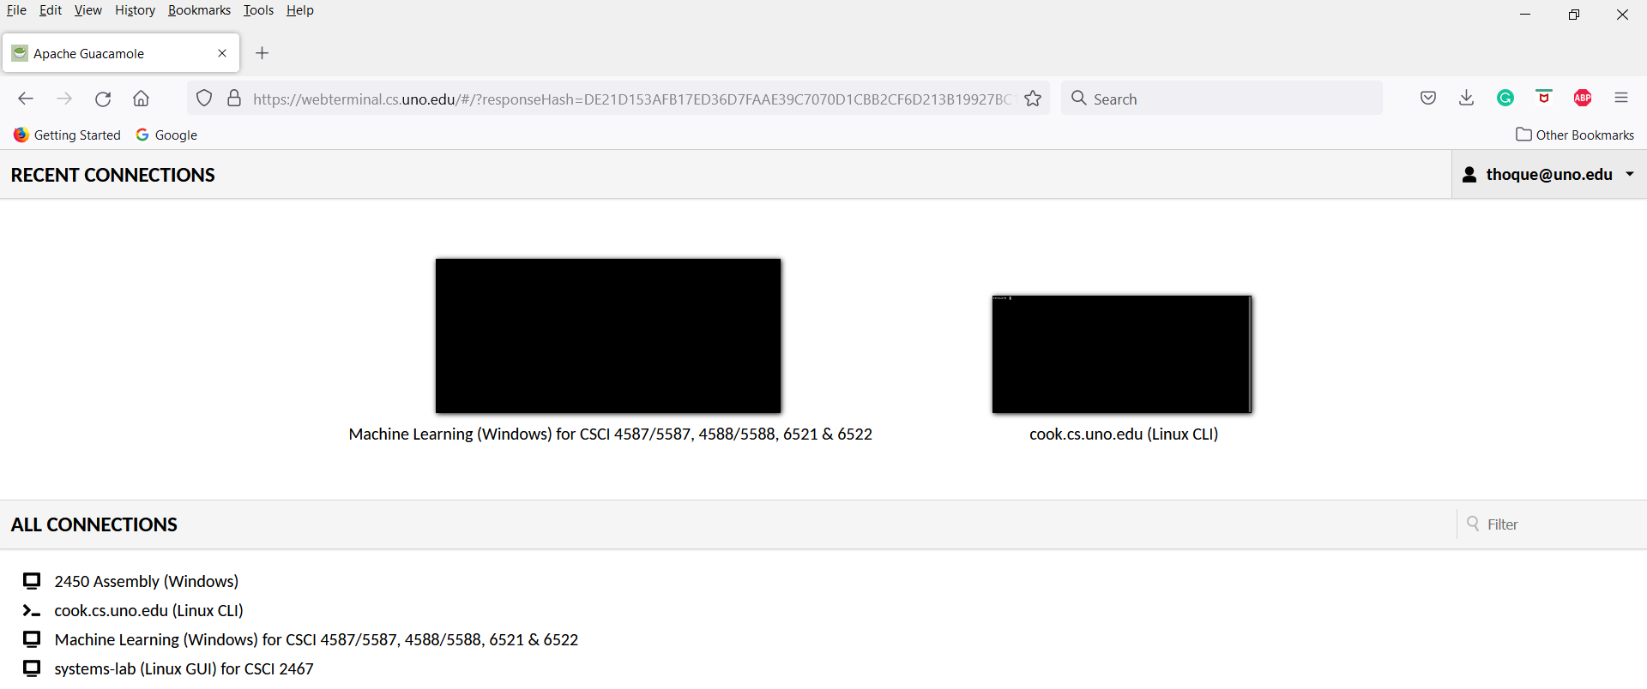
Course Resources
Check Moodle for resources
Please remember:
I often update the lecture notes just before teaching in the class – so if you want to save/print the final copy – please do so after covering it in the class.
Accessing lab computers: webterminal.cs.uno.edu/

Slide 8
Other Offerings
You may be interested in:
Undergrade Machine Learning (ML) and AI Concentration, click-here for the details.
For the Graduate Certificate in ML & AI, click-here for the details.
CSCI 4587/5587 ML I, click-here for a sample syllabus.
CSCI 4588/5588 ML II, click-here for a sample syllabus.
CSCI 6522 Advanced ML II, click-here for a sample syllabus.

Slide 9
Topic Covered
Introduction to various programming aspects, tools, and platforms of machine learning (see more here)
Regression, Classification, and Optimization
Generative Modeling
Autoencoders
Representation Learning and Generative Learning Using Autoencoders and GANs
Paint
Write – Natural Language Generator
Compose
Advanced Generative Modeling
Feature Detection Using Deep Belief Networks
Time Series Clustering
Real-Time Object Classification on iOS with Core ML

Slide 10
Generative Model
Some Preliminaries
Pages: 1 to 7 from the lecture note.

Slide 11
Bias-Variance Decomposition
The variance measures the extent to which the solutions for individual data sets vary around their average and hence this measures the extent to which the function f(X) is sensitive to the particular choice of data set.
The bias represents the extent to which the average prediction over all data sets differs from the desired regression function.

Slide 12
Exercise using Weka
Check Exercise.zip in Moodle
Weka is a java based software to explore machine-learning and Data-mining approaches: http://www.cs.waikato.ac.nz/ml/weka/

Slide 13
Bayes Law/Theorem
Example: Suppose, we have invented an influenza tester. Now, say 5% of the population is sneezing due to the cold season. Running test on sneezing people, 90% test returned positive for influenza testing. Given a person is NOT sneezing the test comes out positive 15% of the time. For a positive detection what is the chance that the person is sneezing?

Slide 14
Some Important Preliminaries
Pages: ~09 to 14 - we will discuss the followings:
Gaussian or Normal Distribution
Probability Density Function
Likelihood Functions
Maximum Likelihood Estimation (MLE)

Slide 15
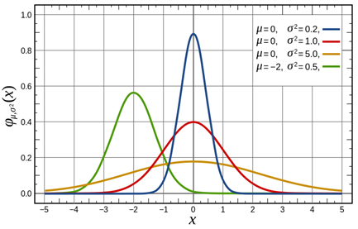
Gaussian Distributions

Slide 16
Generative Model
Definition: A generative model describes how a dataset is generated in terms of a probabilistic model. By sampling from this model, we are able to generate new data.
Example:
Suppose we have a dataset containing images of horses.
We may wish to build a model that can generate a new image of a horse that has never existed but still looks real because the model has learned the general rules that govern the appearance of a horse.
This is the kind of problem that can be solved using generative modeling.

Slide 17
… Generative Model
There has been increased media attention on generative modeling projects such as:
StyleGAN (GAN stands for Generative Adversarial Networks) from NVIDIA, which is able to create hyper-realistic images of human faces, see https://nvlabs.github.io/stylegan2/versions.html
the GPT-2 language model from OpenAI, which is able to complete a passage of text given a short introductory paragraph. See “Language Models Are Unsupervised Multitask Learners”, paper here: https://paperswithcode.com/paper/language-models-are-unsupervised-multitask

Slide 18
Generative Model Framework
We have a dataset of observations X.
We assume that the observations have been generated according to some unknown distribution, p_{data}.
A generative model p_{model} tries to mimic p_{data}. If we achieve this goal, we can sample from p_{model} to generate observations that appear to have been drawn from p_{data}.
We are impressed by p_{model} if:
Rule 1: It can generate examples that appear to have been drawn from p_{data}.
Rule 2: It can generate examples that are appropriately different from the observations in X. In other words, the model shouldn’t simply reproduce things it has already seen.

Slide 19
Presentation Overview
We will discuss the following items mostly by ‘chalk and talk’:
Bayes Theorem (review)
Naïve Bayes Classifier
Laplace Smoothing / Additive smoothing
Gaussian Densities (specially, Multivariate)
Bernoulli Distribution
Gaussian Discriminant Analysis (GDA)

Slide 20
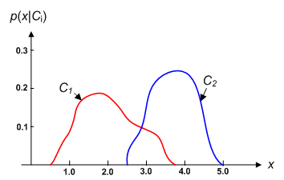
Bayes Law
Figure 1: Hypothetical class-conditional probability density functions show the probability density of measuring a particular feature value x given the pattern is in category C_{i}. If x represent the tumor-size (or the age) the difference in tumor size (or age) of populations of two types of tumor. Density functions are normalized, and thus the area under each curve is 1.0

Slide 21
Naïve Bayes Classifier
Naïve Bayes assumes that the conditional probabilities of the variables are statistically independent. The likelihood is computed as products:

Slide 22
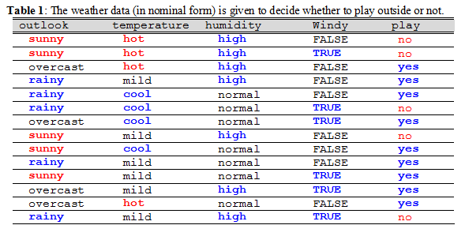
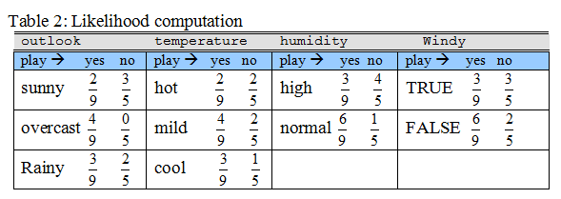
Example 1

Slide 23
Normal/Gaussian Distribution

Slide 24
Multivariate Normal Densities

Slide 25

Quick Review
Bayes rule:
Bayes rule for classification:
Naïve Bayes:

Slide 26
Multivariate Normal Densities
Assume that each of the n random variables x_{i} is normally distributed, each with its own mean and variance, as:
Their joint density can be computed as:

Slide 27
Bernoulli Distribution
In compact form, we can write it:

Slide 28
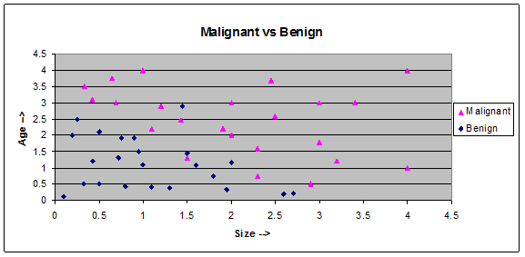
Gaussian Discriminant Analysis
=>

Slide 29
Gaussian Discriminant Analysis …
The pdfs for the classes can be expressed as;

Slide 30
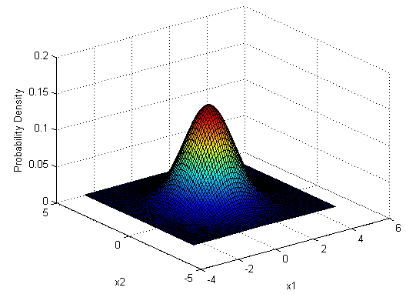
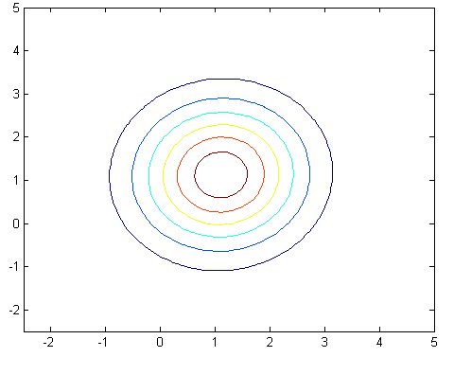
GDA …
(a) (b)
Figure 5: For benign class (a) pdf and (b) contour are shown.

Slide 31
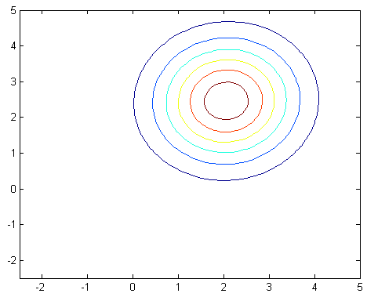
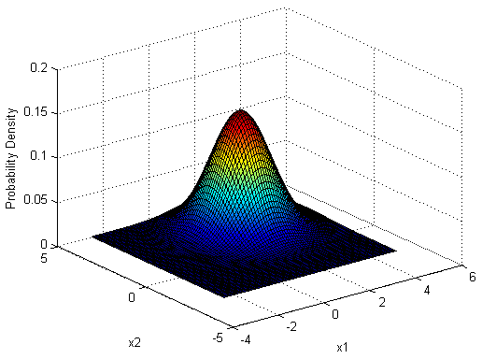
GDA …
(a) (b)
Figure 6: For malignant class (a) pdf and (b) contour are shown.

Slide 32
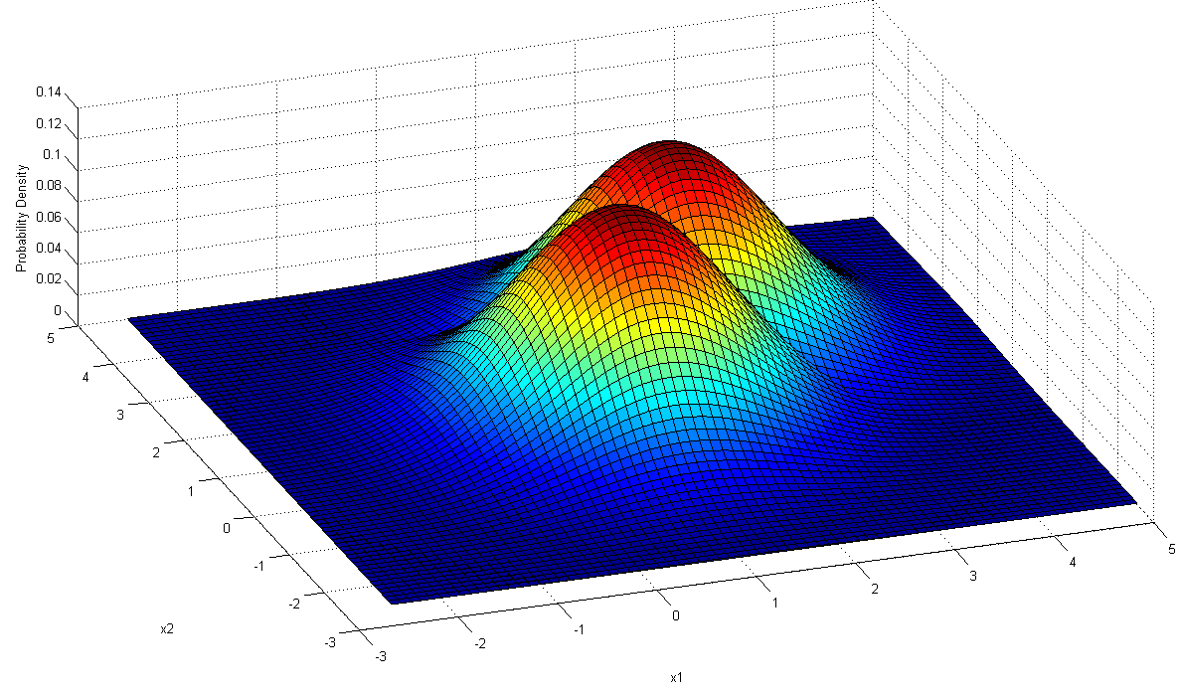
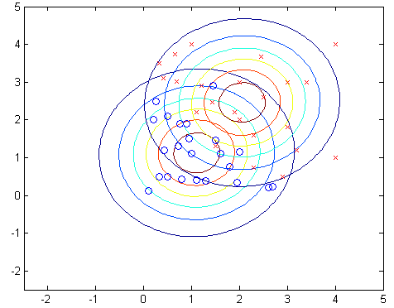
GDA …
(a) (b)

